Slide 1

MSI WIREFRAME REVIEW FEEDBACK

Slide 2
MOJEC ADMIN – MSI (WEB)

Slide 3
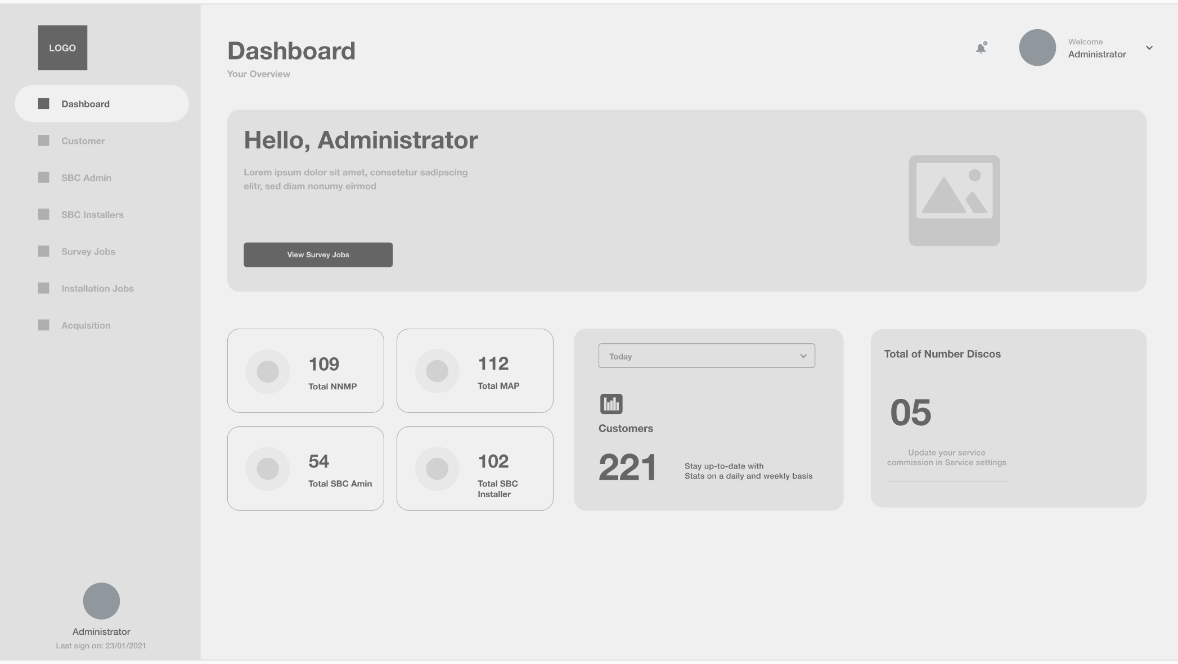
The tabs doesn’t capture some the major admin feature/tabs
Payment
API Configurations
Inventory
Acquisition
Notification management
User management
Etc.
The dashboard doesn’t show comprehensive dashboard metrics described in the specification document

Slide 4
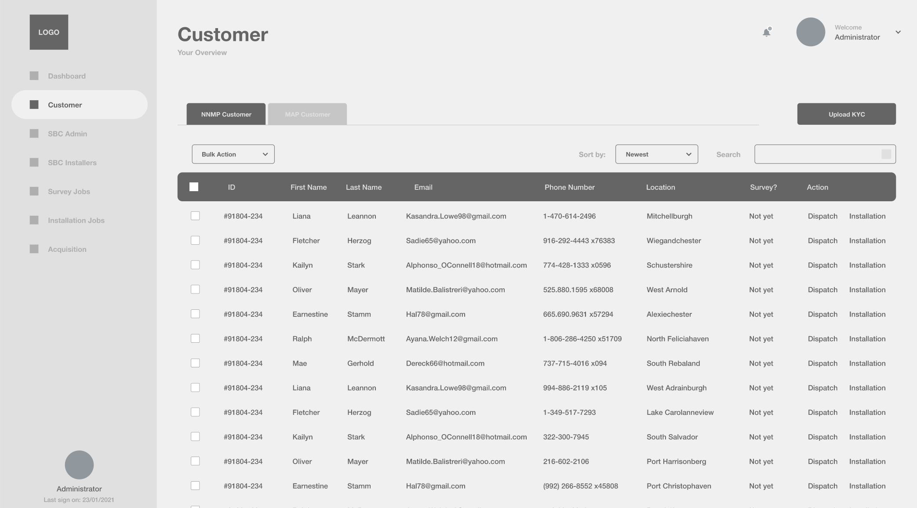
The fields displayed in the customer records have complete KYC parameters
The admin should be able to sort and filter the customer report by all the present fields
After KYC upload, a message update regarding the data validation should be displayed

Slide 5
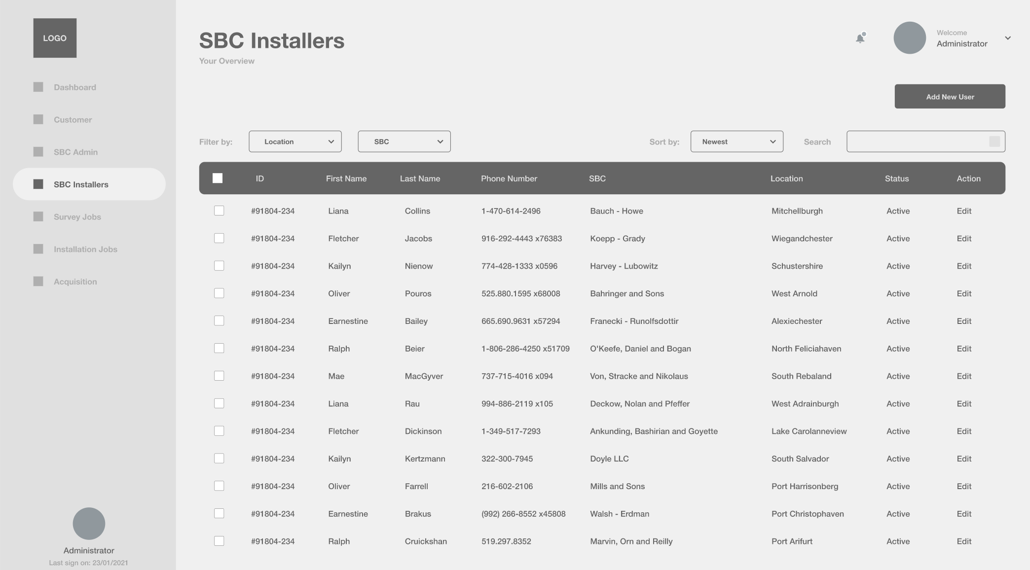
The fields in this SBC record should match the complete

Slide 6
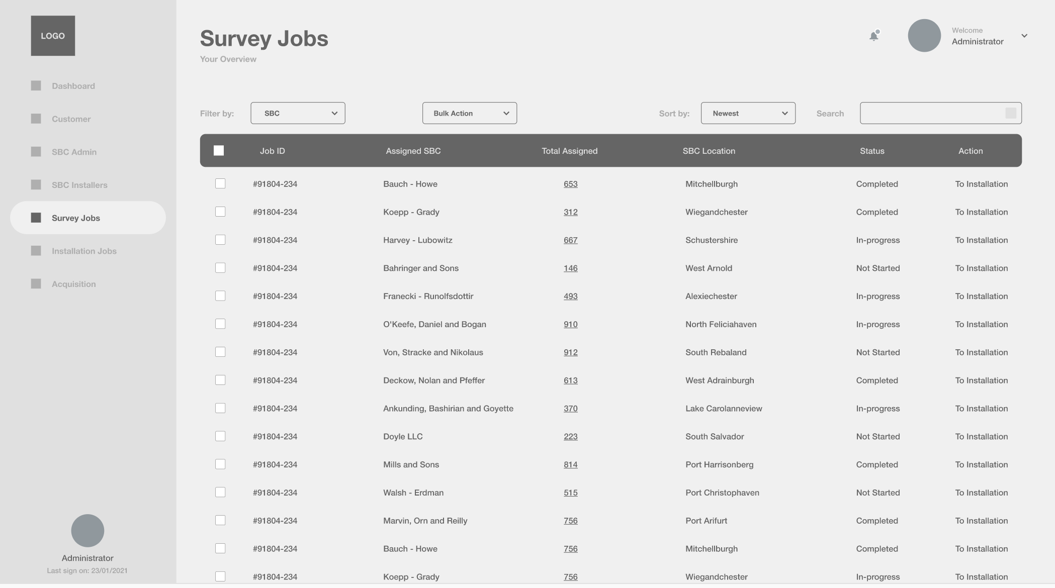
The fields in the Survey Jobs report should speak to the survey task carried out and survey checklist.
Job Dispatch isn’t available in the wireframe.

Slide 7
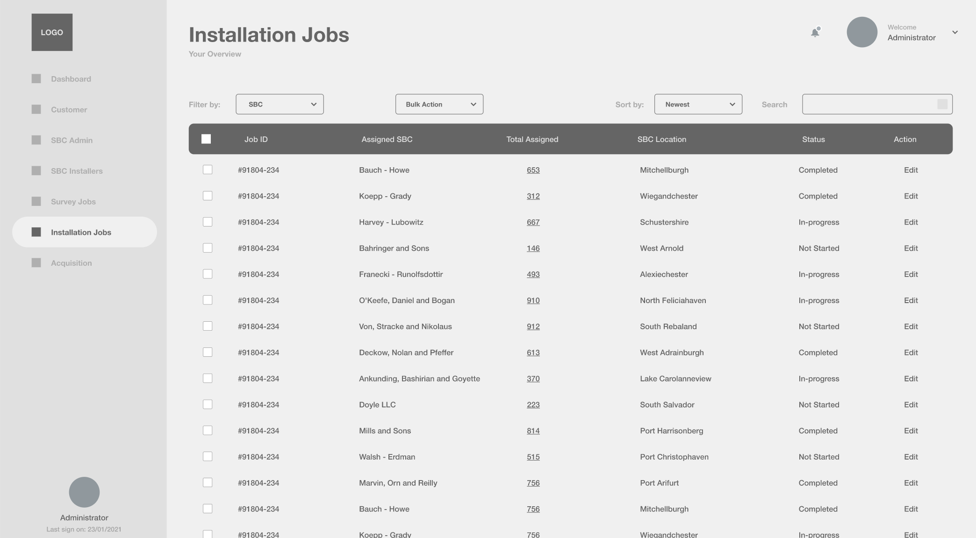
The fields in the Installtion Jobs report should speak to the Installation task carried out and survey checklist.

Slide 8
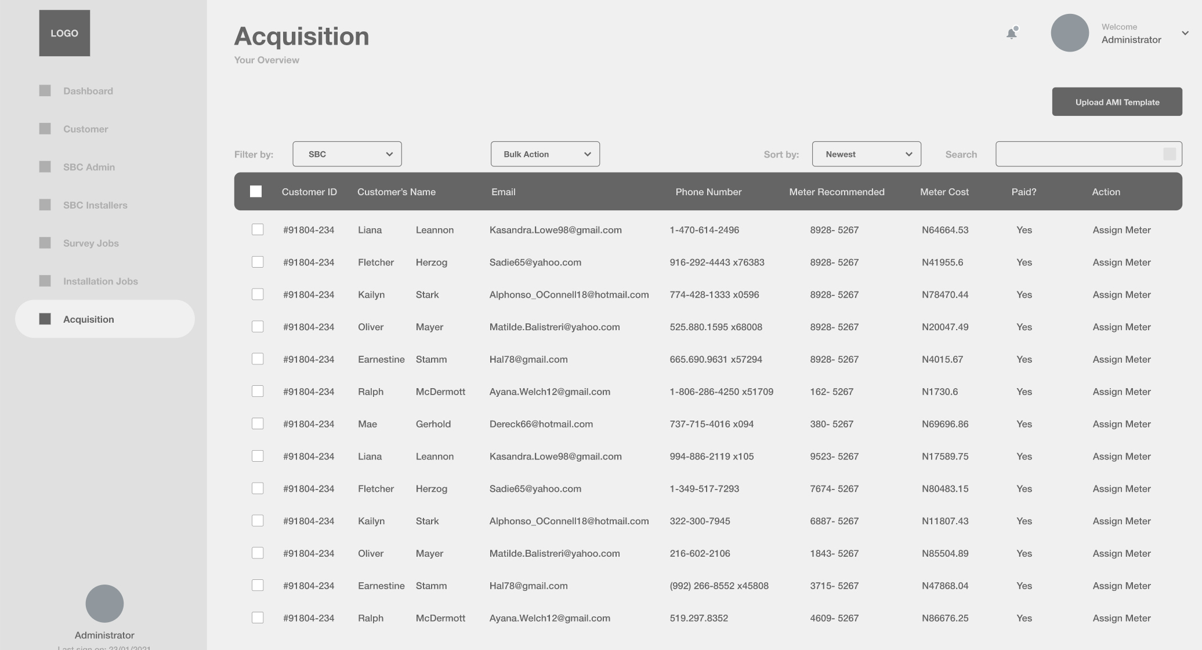
The acquisition report should signify the match of customers to their respective meter numbers. This doesn’t show on the wireframe
The download template isn’t present in the wireframe

Slide 9
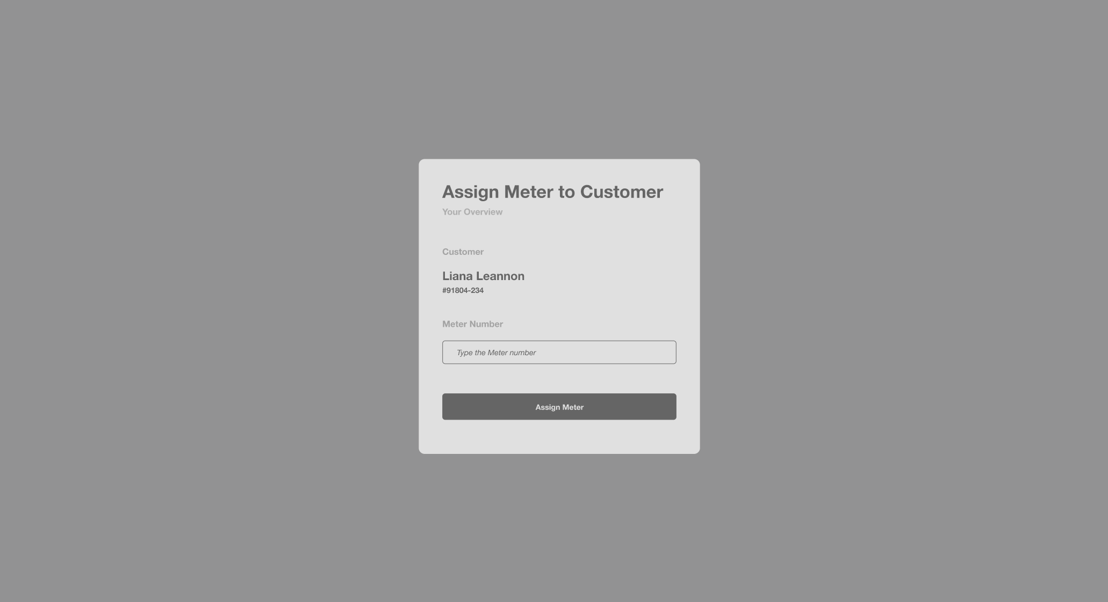
Meter assignment to customer is done via template upload in addition to a manual option(GUI).

Slide 10
MOJEC SBC ADMIN – MSI (WEB)

Slide 11
The acquisition report should signify the match of customers to their respective meter numbers. This doesn’t show on the wireframe

Slide 12
General Feedback
The wireframe doesn’t describe the complete features of the application.
The Figma link shared is the same as that of MSH. Is this a mixup ?

